Slide 1
Movie Analysis
2010-2019

Slide 2
Overview
Data Exploration
Business Question
Chart
Data Cleaning

Slide 3
Data Exploration
Explored IMDB movie data from **2010 to 2019**
Focused on genre trends and audience ratings
Joined `movie_basics` and `movie_ratings` tables using SQL
Cleaned and filtered data for valid genres and non-null ratings
Calculated average ratings and movie counts per primary genre
Found **Documentary**, **Biography**, and **Animation** had the highest average ratings

Slide 4
Business question
Which movie genres consistently receive the highest average audience ratings, and should studios prioritize those genres for future production?

Slide 5
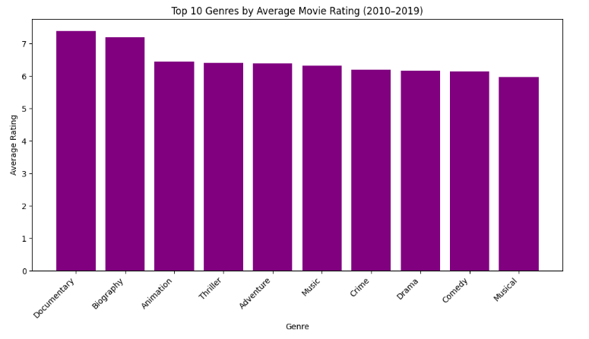
Supporting Visual / Chart
Bar chart created in Python showing:
The bar chart below, created in Python, highlights key findings from the data analysis:
The top 10 movie genres based on average audience ratings
Genres are displayed as purple bars for clear visual comparison
Rating values range from approximately 5.5 to 7.5 across genres
This visualization helps identify genres with the strongest viewer approval, potentially guiding content investment and production priorities

Slide 6
Data Cleaning
Removed rows with null or blank genres
Filtered to movies released only between 2010 and 2019
Removed movies with null averageRating
Extracted only the first genre from comma-separated genre values
Excluded genres with fewer than 5 movies to improve reliability
Trimmed extra spaces using SQL TRIM() to ensure consistent grouping

Slide 7
Conclusion
Documentary, Biography, and Animation had the highest average ratings
These genres may connect better with audiences
Studios could focus more on these top-rated genres
More analysis can be done on things like runtime or cast

